Slide 1
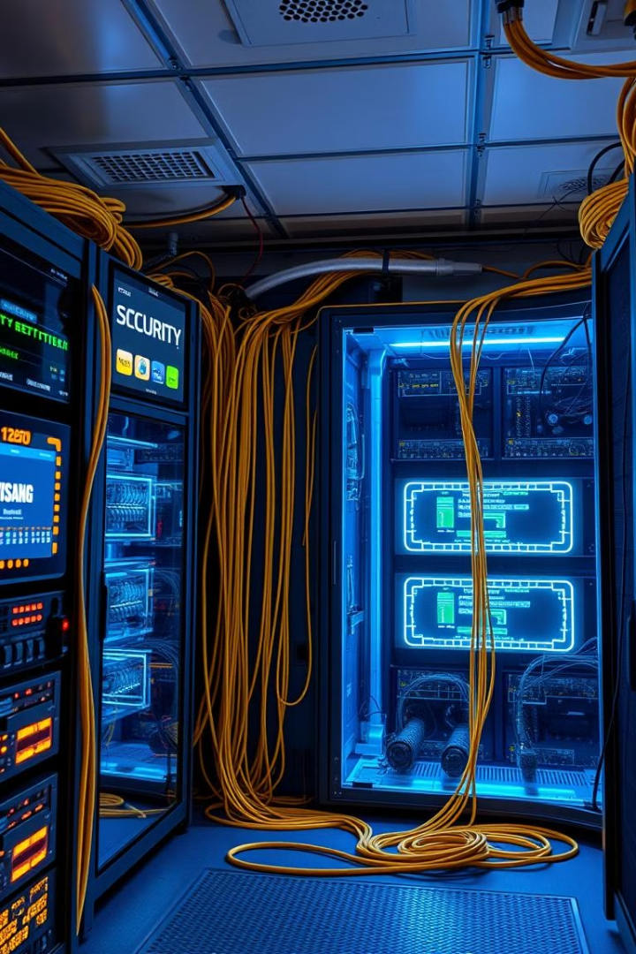
Wazuh
(Security Platform)
Presented by:
Zainab Mushtaq BSIT51F21S006

Slide 2

Wazuh: Comprehensive Security Platform
Wazuh, an open-source security platform designed to enhance your organization's security posture. Wazuh offers a robust suite of features, including endpoint detection and response (EDR), Security Information and Event Management (SIEM), and compliance management, ensuring comprehensive threat detection and response across your infrastructure. This presentation will explore key features, installation, configuration, and real-world use cases.

Slide 3
Wazuh: Key Features and Use Cases
Key Features
Use Cases
Endpoint Detection & Response (EDR)
Compliance Auditing (GDPR, SOC 2)
Security Information & Event Management (SIEM)
Malware Detection
File Integrity Monitoring (FIM)
Vulnerability Assessment
Threat Intelligence Integration
Log Management & Analysis
Compliance Management
Threat Hunting
Cloud Security Monitoring

Slide 4
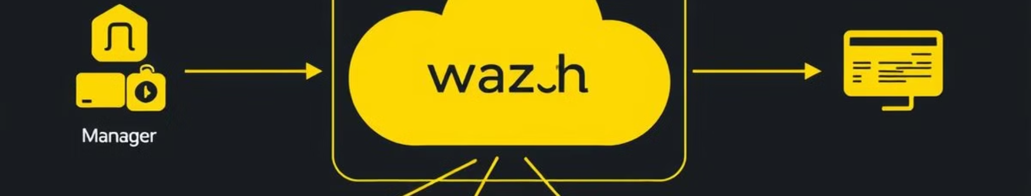
Wazuh Architecture: A Unified Approach
Wazuh Manager
Wazuh Agents
Centralized server for data analysis and event correlation.
Deployed on monitored endpoints to collect security data.
Elasticsearch
Wazuh Dashboard
Stores and indexes security data for efficient analysis and querying.
Web interface for monitoring, configuration, and visualization of security data.

Slide 5
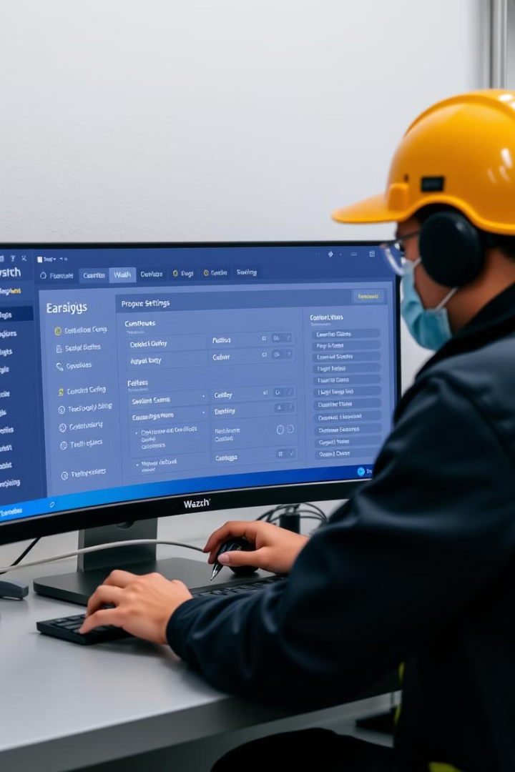




Configuring Wazuh: Tailoring Security Needs
Connecting Wazuh Manager
Enabling Modules
Establish a seamless connection between the Wazuh Manager and Elasticsearch for data storage and analysis.
Enable essential modules such as File Integrity Monitoring, log collection, and vulnerability detection to enhance security posture.
Configuring Agents
Setting up Rules and Decoders
Configure Wazuh agents deployed on endpoints to effectively collect and report security data to the manager.
Define specific rules and decoders for the Wazuh system to identify and categorize potential threats based on your organization's requirements.

Slide 6
Installation Overview: Getting Started
1
Prerequisites: Supported operating systems (Linux, Windows, macOS). Ensure sufficient hardware and software resources for optimal performance.
2
Installation Steps: Wazuh Manager setup, Elasticsearch installation, Wazuh Dashboard installation, and agent deployment on monitored endpoints.
3
Configuration: Connect Wazuh Manager to Elasticsearch, enable necessary modules (FIM, log collection, vulnerability detection), and configure Wazuh agents for optimal data collection and analysis.

Slide 7
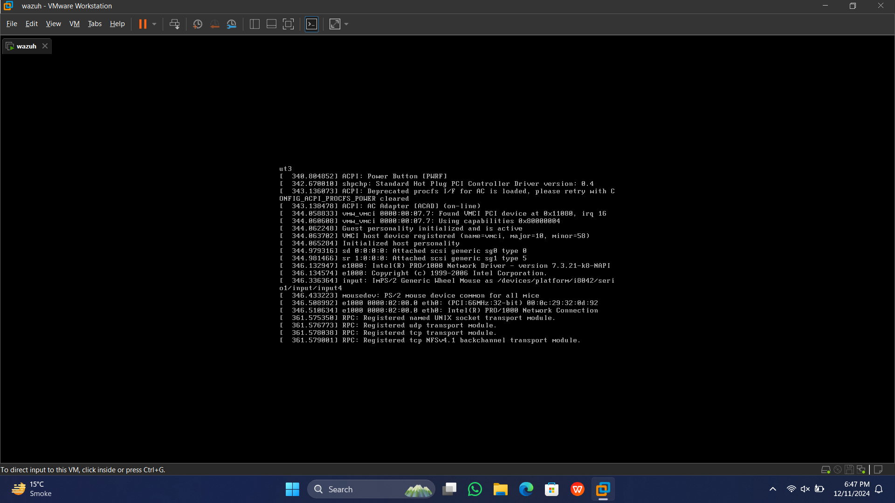

Slide 8


Slide 9
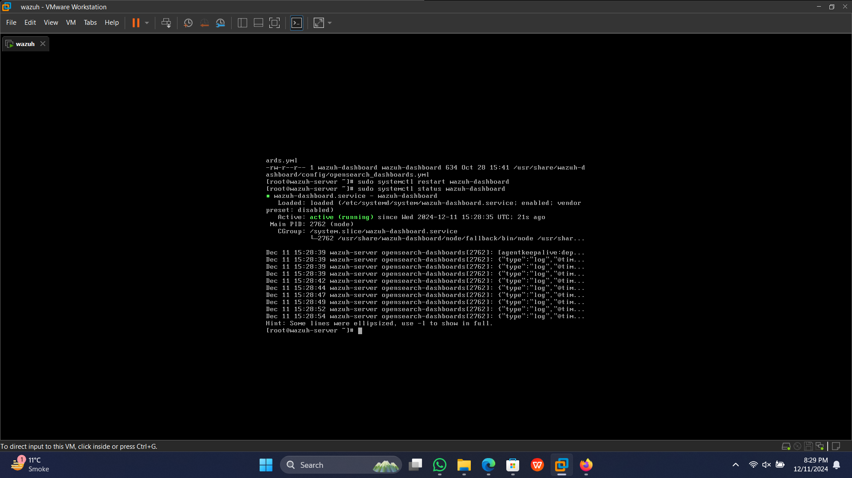

Slide 10
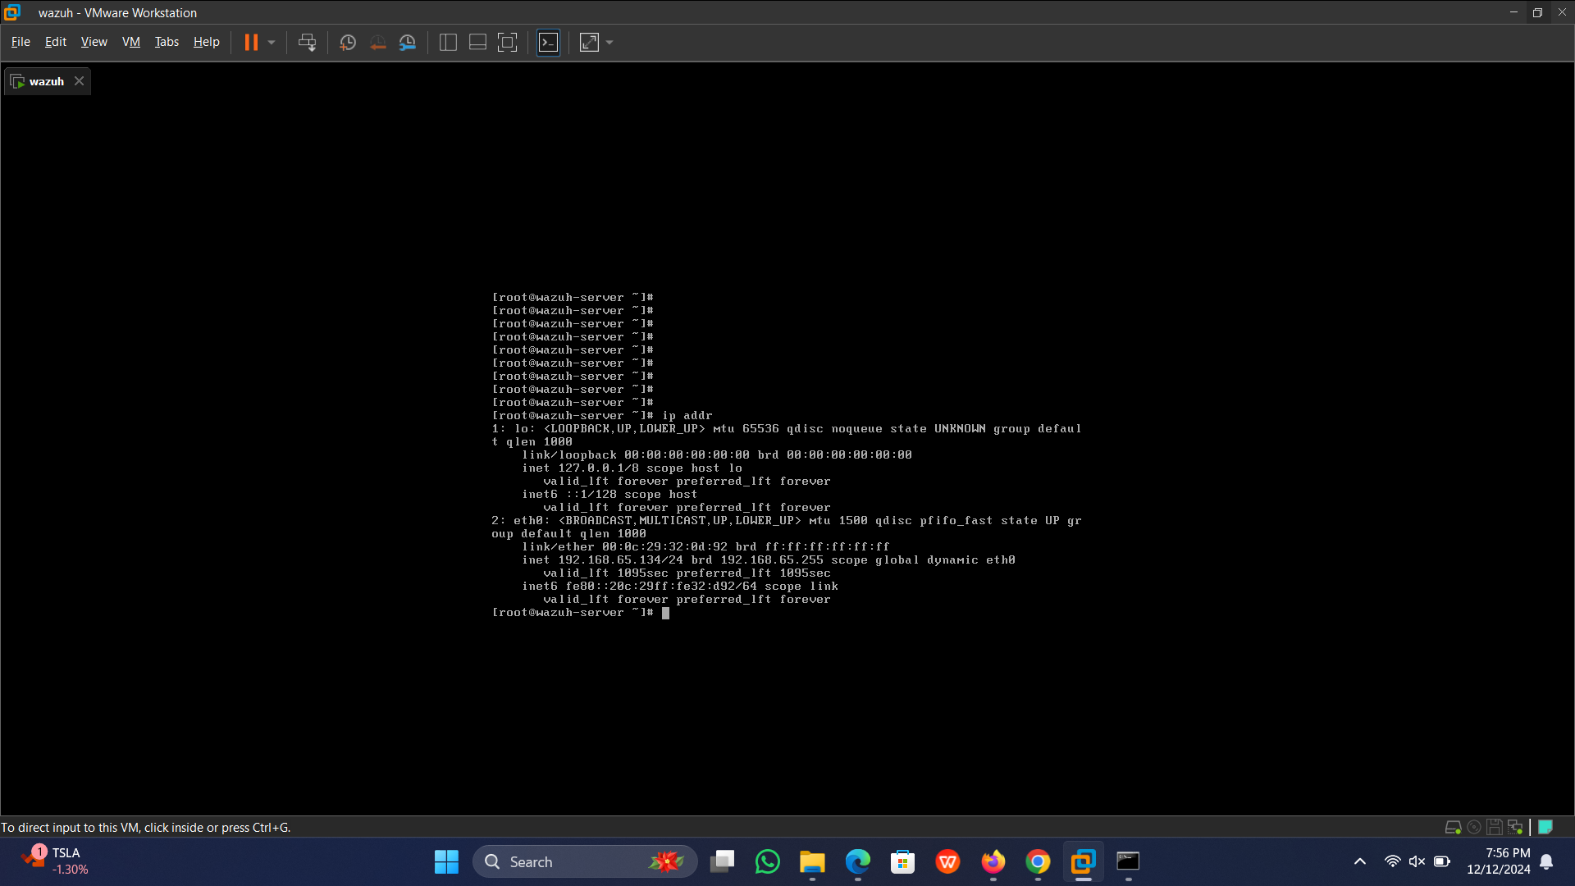

Slide 11
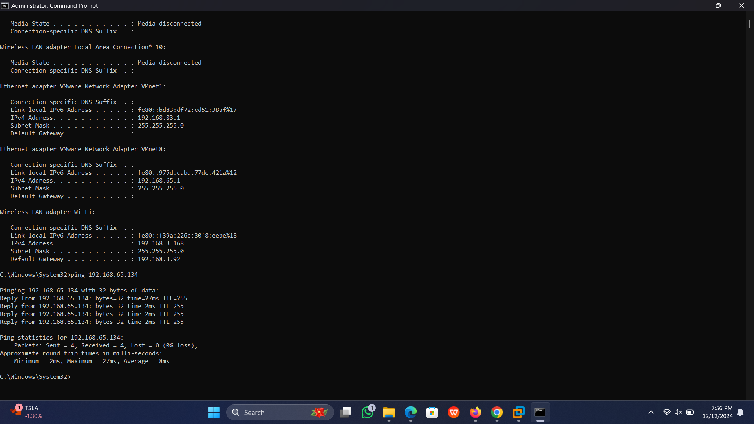

Slide 12
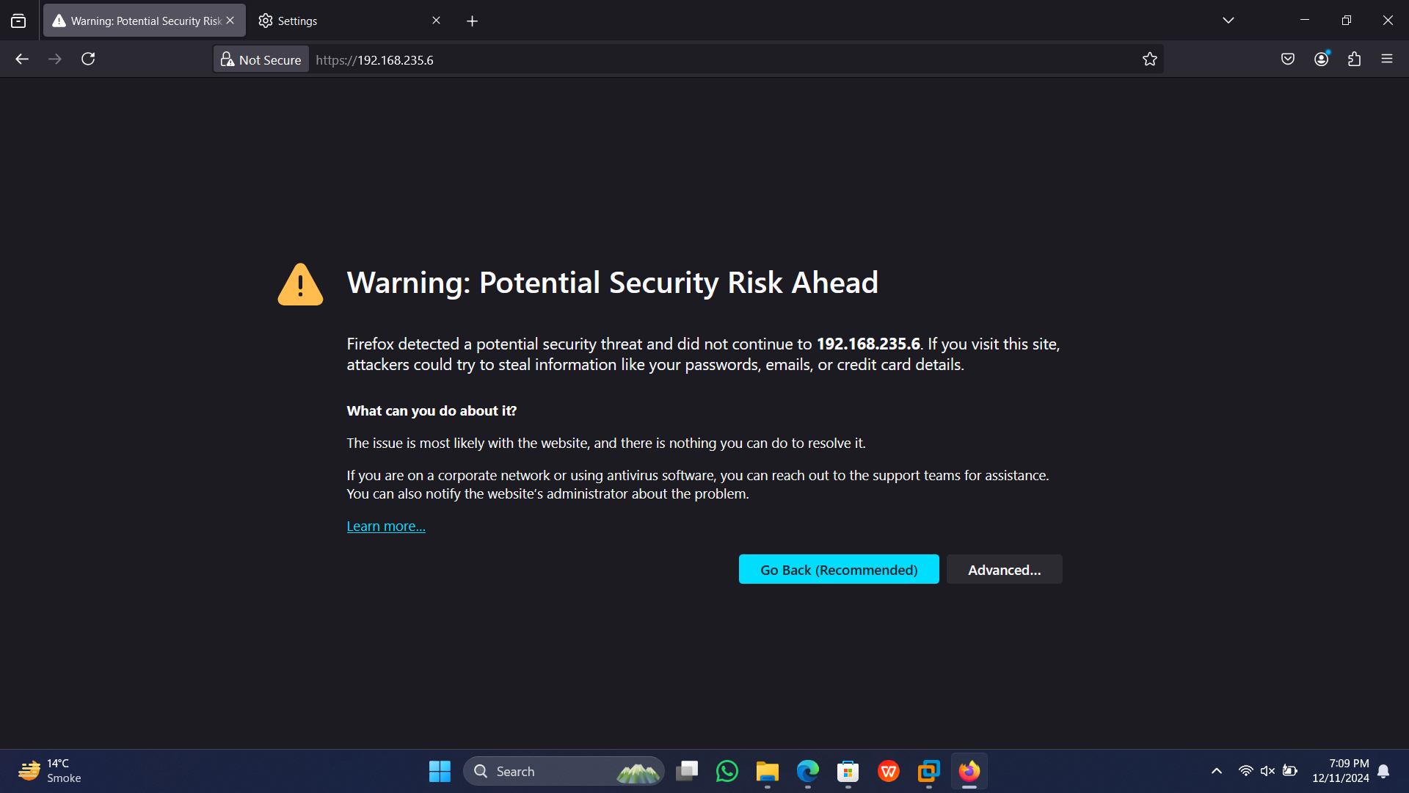

Slide 13
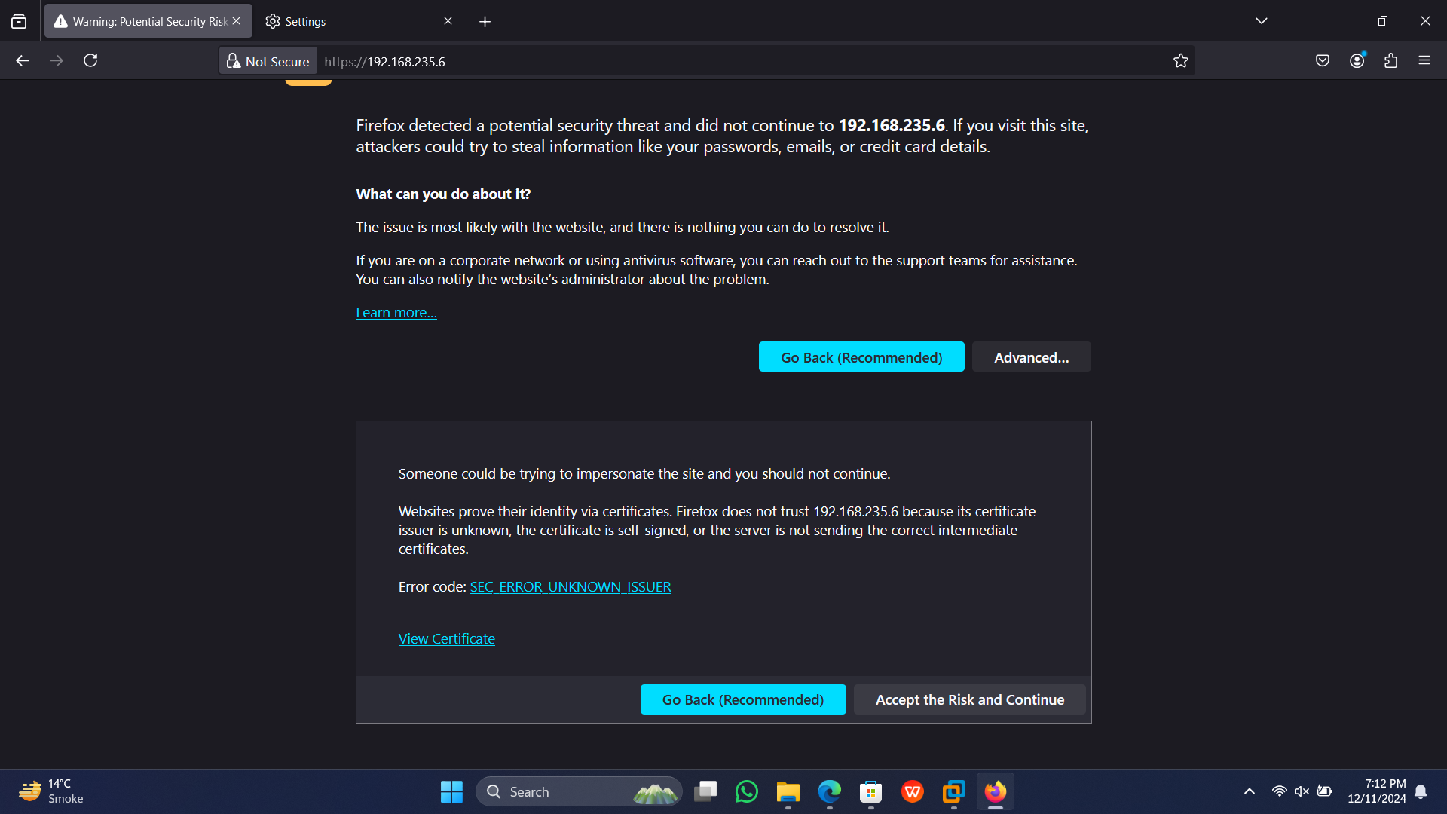

Slide 14
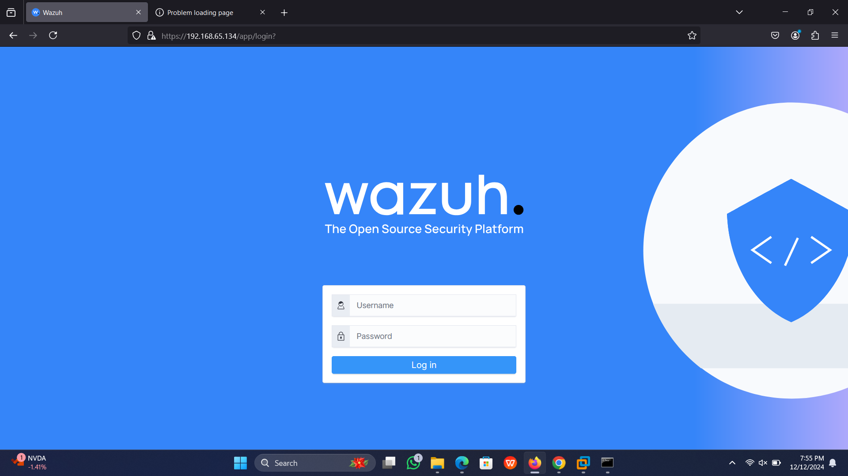

Slide 15
Wazuh Dashboard: Monitoring and Management
1
Endpoint Security
Monitor endpoint security status, identify potential threats, and perform remediation actions.
2
Threat Intelligence
Integrate with external threat intelligence feeds for timely and accurate threat detection and analysis.
3
Compliance Management
Ensure compliance with industry standards like GDPR, PCI DSS, and HIPAA through comprehensive reporting and auditing capabilities.

Slide 16
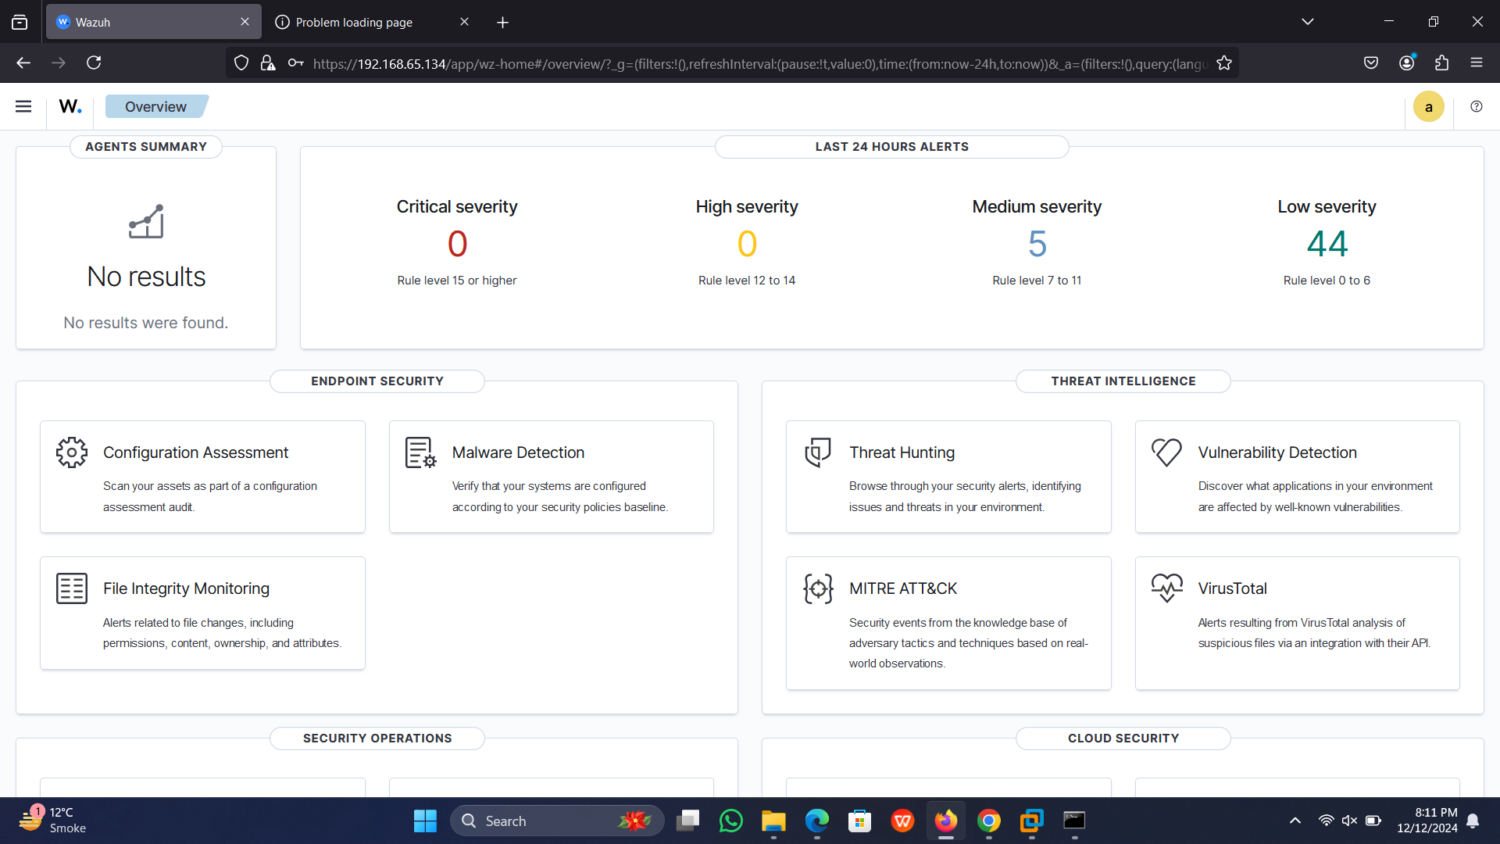

Slide 17




Managing Wazuh Agents: Ensuring Visibility and Control
Agent Deployment
1
Install Wazuh agents on monitored endpoints to collect security data and enhance visibility.
Agent Registration
2
Register agents with the Wazuh Manager to establish communication and centralize data management.
Agent Configuration
3
Manage agent configurations to customize data collection and reporting based on specific endpoint needs.
Agent Logs and Troubleshooting
4
Access and analyze agent logs to troubleshoot connectivity issues and ensure smooth operation.

Slide 18
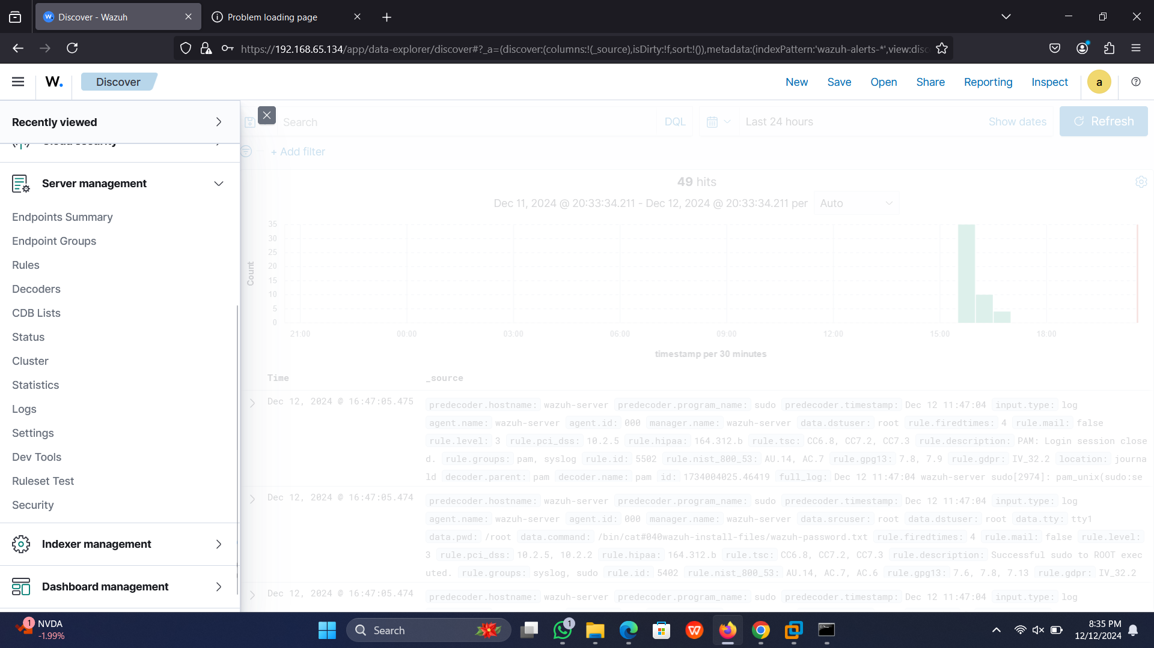

Slide 19
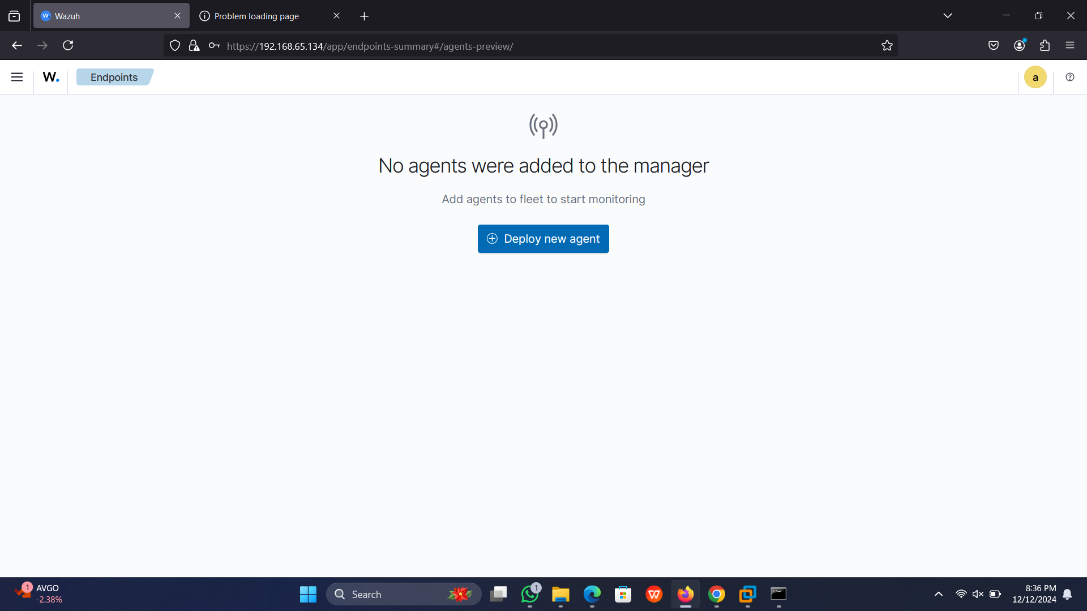

Slide 20
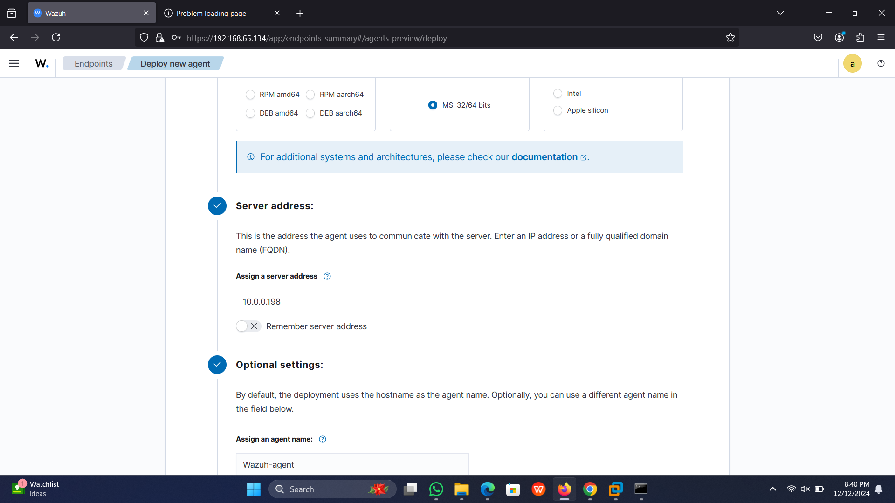

Slide 21
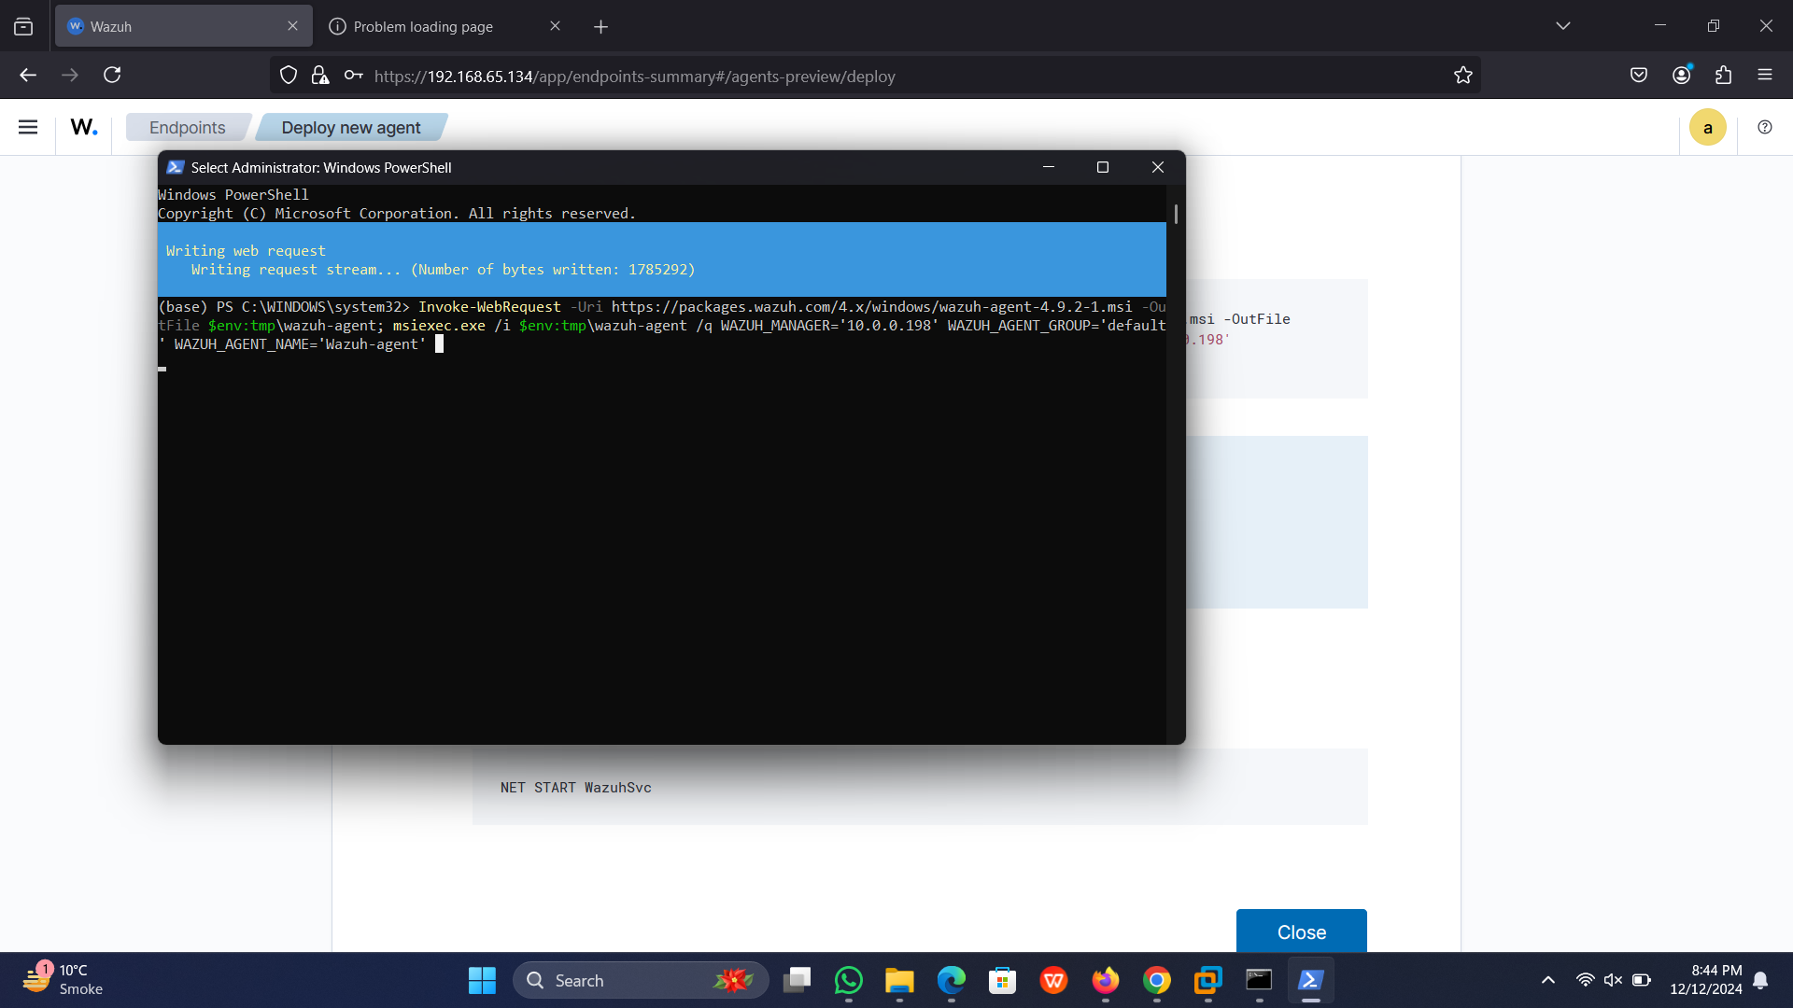

Slide 22
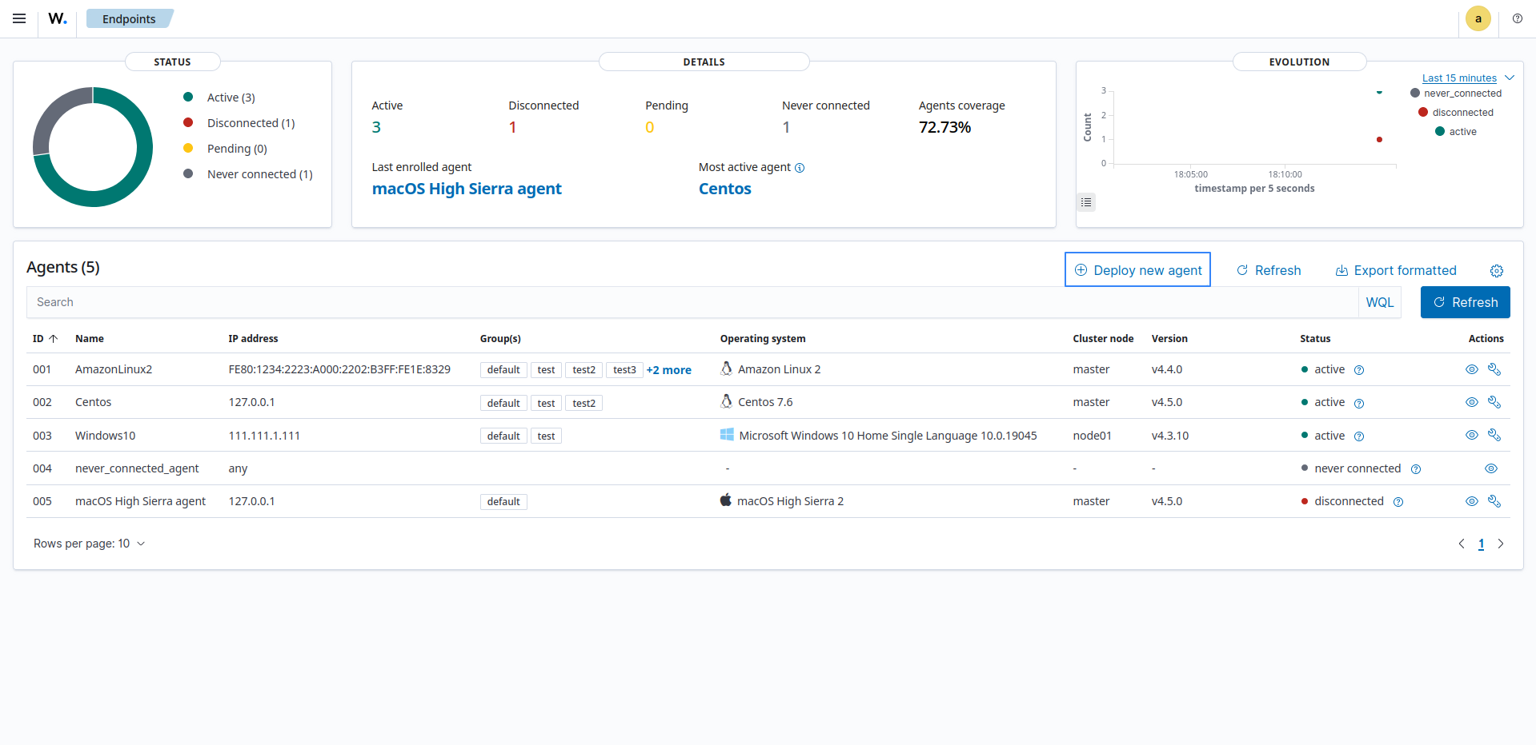

Slide 23



Threat Detection and SIEM Capabilities
Wazuh collects security data from agents, including system logs, network traffic, and file system changes.
Using predefined rules and threat intelligence feeds, Wazuh analyzes data to identify suspicious activities and potential threats.
Example: Wazuh detects a failed login attempt on a server, triggering an alert to the security team for immediate investigation and response.

Slide 24
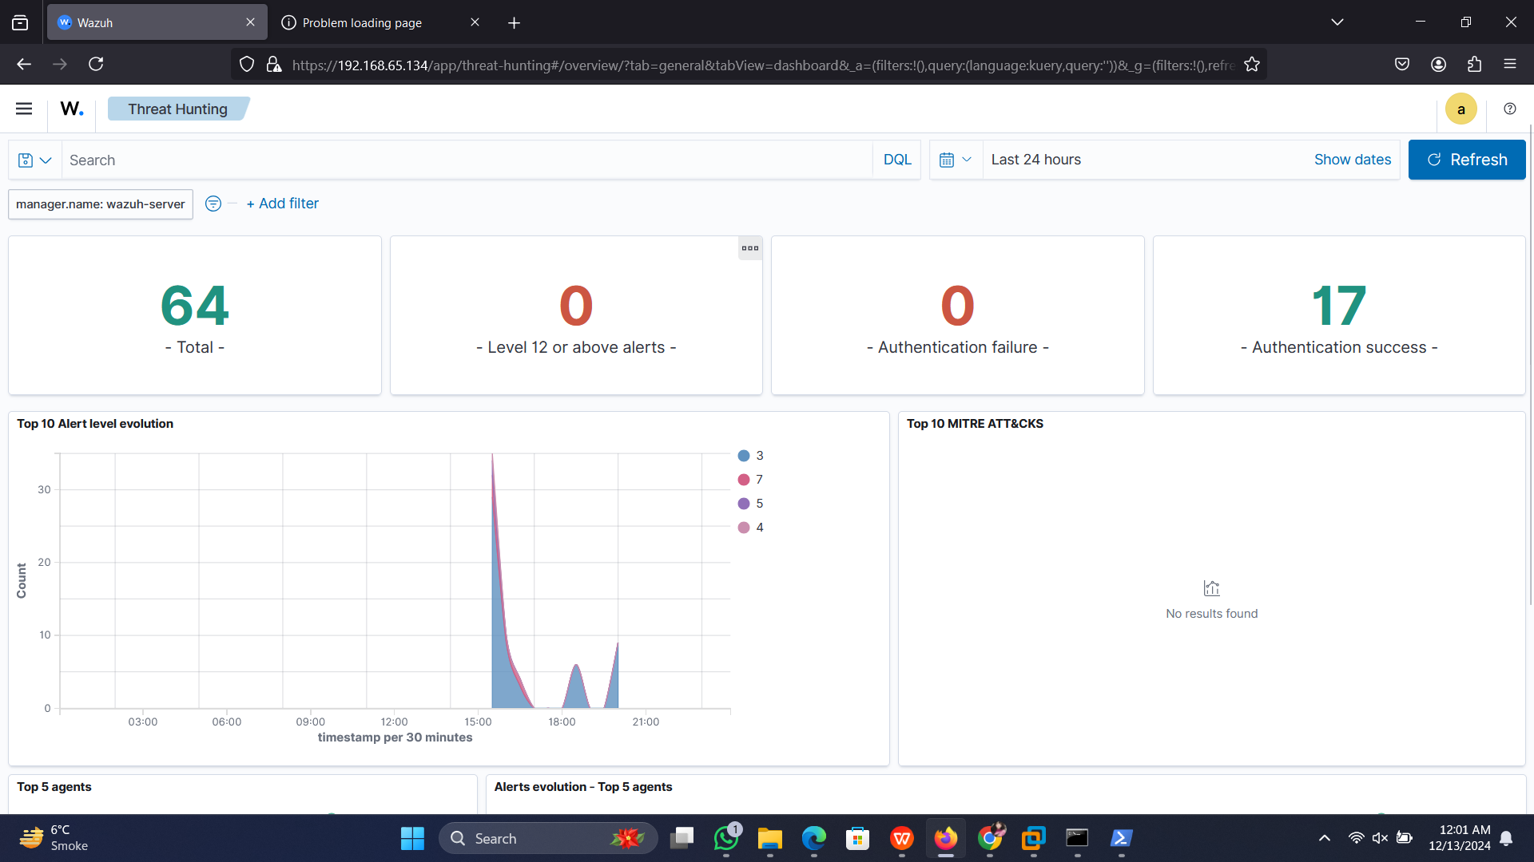

Slide 25
Alerting and Logging: Monitoring and Analysis
Alert Levels
1
Configure alert levels (Critical, High, Medium, Low) to prioritize security events based on their severity and potential impact.
Viewing Logs
2
Access detailed logs to understand the context of security events and troubleshoot potential issues.
Example Alerts
3
Wazuh generates alerts for events like malware detection, system intrusion attempts, and unauthorized file modifications.

Slide 26
THANK YOU!

